Slide 1

Excel 101
Accounting Basics

Slide 2
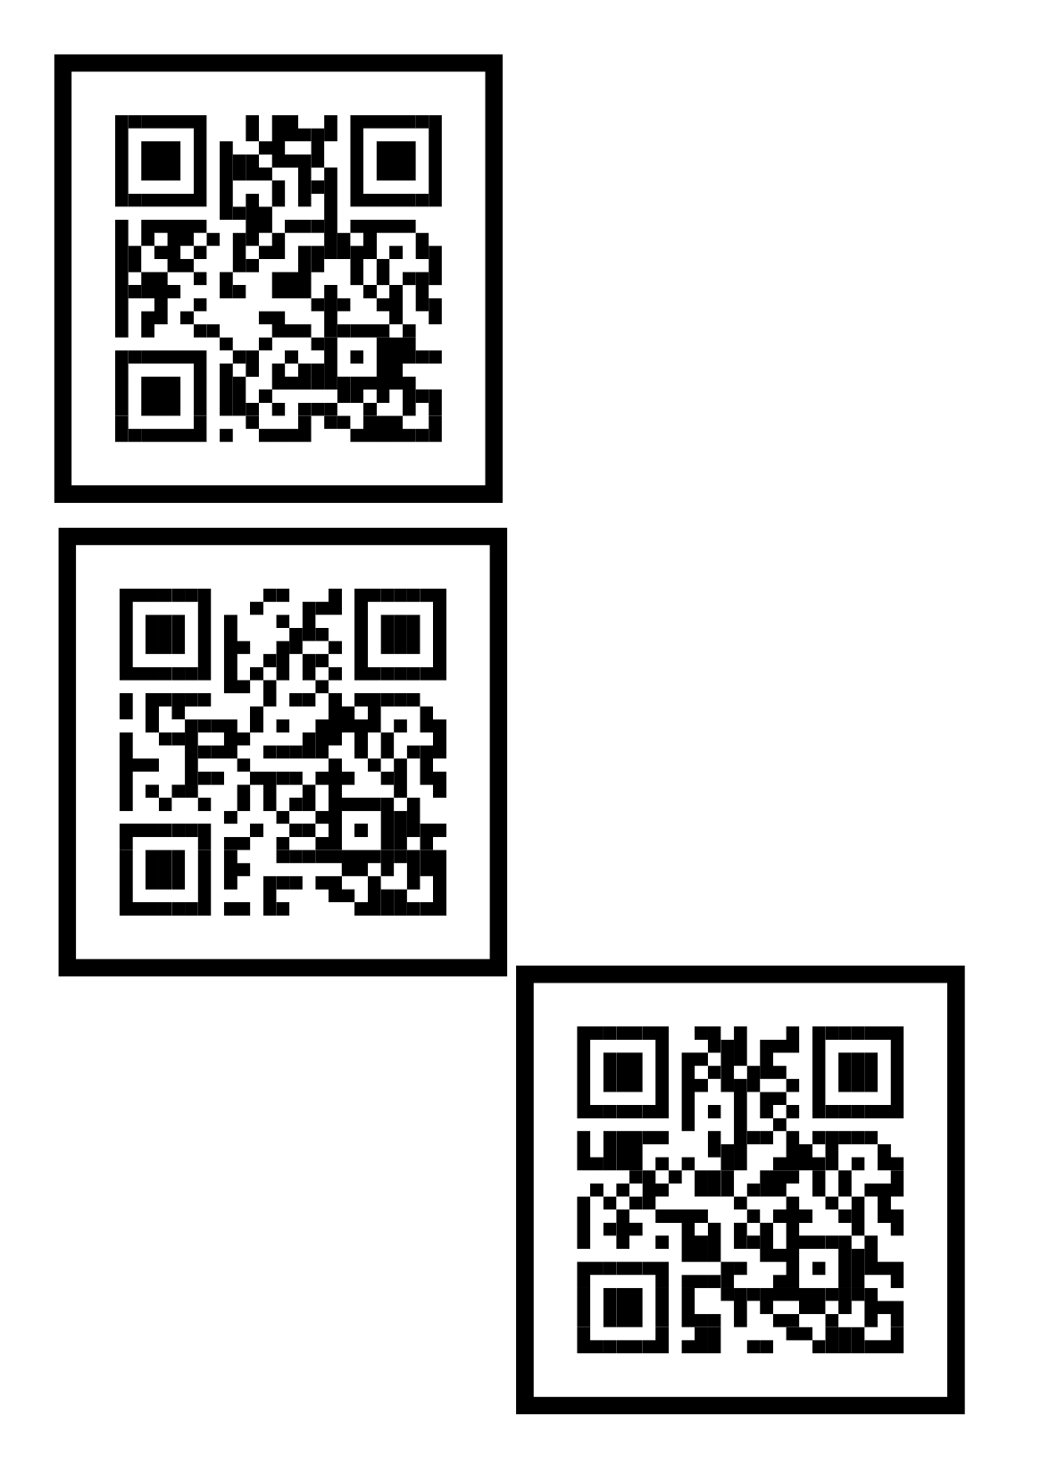
Lesson File
bit.ly/iwantexcelac

Slide 3

Cheat Sheet
(for users)
bit.ly/stcexcelacs

Slide 4
Designing Ledgers
Ledger No. 1
Tools used:
Borders
Basic formulas (“=, SUM”)
Font formatting (“Bold, Font”)
Number formatting (“Accounting”)
Custom cell formatting (e.g. “SOFP –”)
Indents
Date functions (“DATE”)
Optional: (“NOW”)
"SOFP - "@
=NOW()
=DATE(YEAR(N23),12,31)

Slide 5
Designing Ledgers
Input = '009001-01
Ledger No. 2
Tools used:
Prefix (using apostrophe, ’ )
Borders
Basic formulas (“=, SUM”)
Conditions (“IFERROR”)
Hyperlinks
Font formatting (“Bold, Font”)
Date functions (“DATE”)
Indents, Merging etc.
=IFERROR((U53+R54-T54),R54-T54)
Cell Reference = “N59”

Slide 6
Creating Timelines
Timeline No. 1
Tools used:
“Insert Shape(s)”
Font formatting (“Bold, Font”)
Date functions (“EOMONTH, DATE”)
Gradient fill
Merging
=EOMONTH(DATE(YEAR(L21),MONTH(L21)+6,DAY(L21)),0)

Slide 7
DIY Income Tax Table
=$L$12-K15
Income Tax Table 1
Tools used:
Basic formulas (“=, * ”)
Borders
Reference locking (“ $ ”)
If Statements (“ > ”)
Font formatting (“Bold, Font”)
Infinity formula
=IF(P20>0,P20,0)
=1E+99

Slide 8
Budgeting
='4 BUDGETING'!$K$40:$K$49,'4 BUDGETING'!$M$40:$N$49
=(S18/R18)-1
Budget Table 1
Tools used:
Basic formulas (“ =, / , ( … ) ”)
Conditional formatting (“Less Than…”)
Font formatting (“Bold, Underline”)
“Insert Chart”
Indents, Merging, Borders etc.
=1-(N27/M27)
Cell Value < 0
='4 BUDGETING'!$K$40:$K$49,'4 BUDGETING'!$M$40:$N$49

Slide 9
Financial Formulas, Ratios
Exercise 1
How does the
NPV Formula work?
Discount rate component is x % or 0.x
Include only “positive” cash flows beginning from second year onwards
Don’t forget to set-off against “Initial Investment”

Slide 10
Financial Formulas, Ratios
Exercise 1
How does the
IRR Formula work?
Just like a “SUM” formula
“Initial Investment” is deemed to be incurred in Year 0

Slide 11
Financial Formulas, Ratios
Exercise 2
How does the
SLN Formula work?
“Consideration Paid”
“Salvage Value”
“Useful Life”

Slide 12
Financial Formulas, Ratios
Exercise 2
How does the
DB Formula work?
“Consideration Paid”
“Salvage Value”
“Useful Life”
+ Period

Slide 13
Financial Formulas, Ratios
Exercise 3
How does the
RATE Formula work?
“Period (Years)”
Make sure “Repayment” is Annual and negative
“Loaned Amount” is positive
… Use zeroes as default for the rest

Slide 14
Financial Formulas, Ratios
Exercise 3
How does the
PMT Formula work?
Make sure Period figure is annualized (i.e. year-only)
For formula, “Annual Rate” is presented as monthly
Future value must be separately calculated
… Use zeroes as default for the rest

Slide 15
Financial Formulas, Ratios
Exercise 3
How does the
PPMT Formula work?
Unlike PMT, PPMT uses an annual interest rate
Periods (e.g. 1-5) must be stated
Total periods (e.g. 5)
“Loaned Amount” is positive, same as PMT

Slide 16
Financial Formulas, Ratios
Ratios, Exercise 1
Components
Hyperlink to website for referencing
Standard formatting basics (“Borders”, “Alignment”, “Indent”)
Basic formulas (“SUM”, “ * ”)
Reference locking

Slide 17
Financial Formulas, Ratios
Ratios, Exercise 1
1. Hyperlink to website for referencing

Slide 18
Financial Formulas, Ratios
Ratios, Exercise 1
2. Standard formatting basics (“Borders”,
“Alignment”, “Indent”, “Fill”)

Slide 19
Financial Formulas, Ratios
Ratios, Exercise 1
=SUM(O183:O184)
=N179/N186
=N189*$P189
3. Basic formulas (“SUM”, “ * ”, “ / ”)

Slide 20
Financial Formulas, Ratios
Ratios, Exercise 1
=N189*$P189
4. Reference locking

Slide 21
Data Sanitization & Analysis
Unsorted Data 1
Rationalizing the data requires:
Understanding of what a Trial Balance is;
“Sanitization” (i.e. removal) of filler data, e.g. “NOT AVAILABLE”;
“Text to Columns”
“SUM”;
“VLOOKUP”; and
“PivotTable”

Slide 22
Data Sanitization & Analysis
Unsorted Data 1
Rationalizing the data requires:
Understanding of what a Trial Balance is
    A trial balance is a bookkeeping or accounting report that lists the balances in each of an organization's general ledger accounts. (Often the accounts with zero balances will not be listed.) The debit balance amounts are listed in a column with the heading "Debit balances" and the credit balance amounts are listed in another column with the heading "Credit balances." The total of each of these two columns should be identical.
https://www.accountingcoach.com/blog/what-is-a-trial-balance

Slide 23
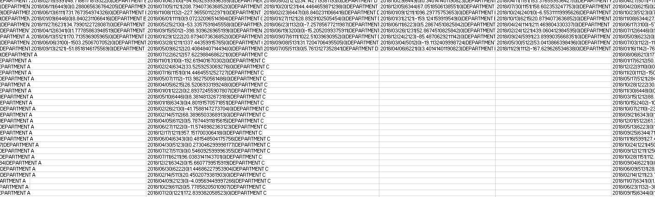
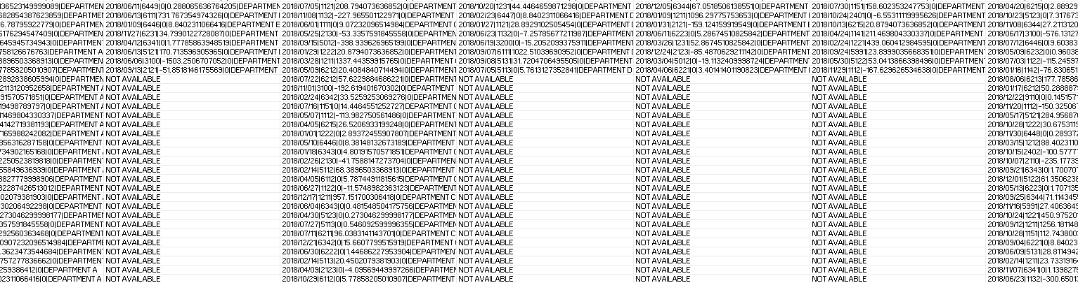
Data Sanitization & Analysis
Unsorted Data 1
Rationalizing the data requires:
“Sanitization” (i.e. removal) of filler data, e.g. “NOT AVAILABLE”

Slide 24
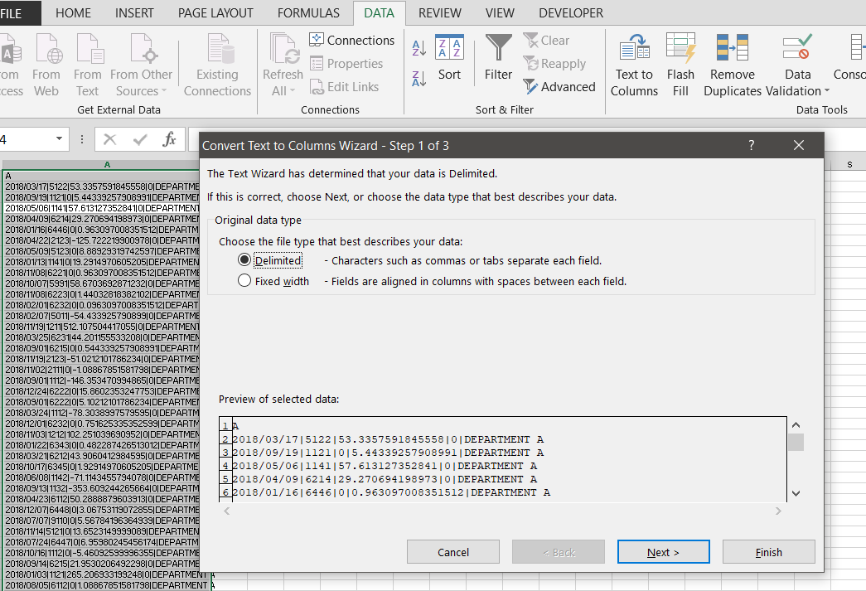
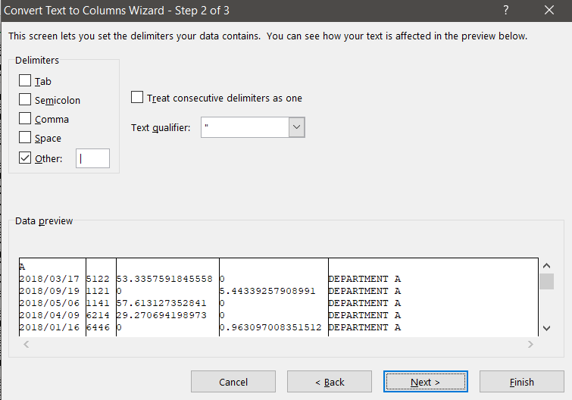
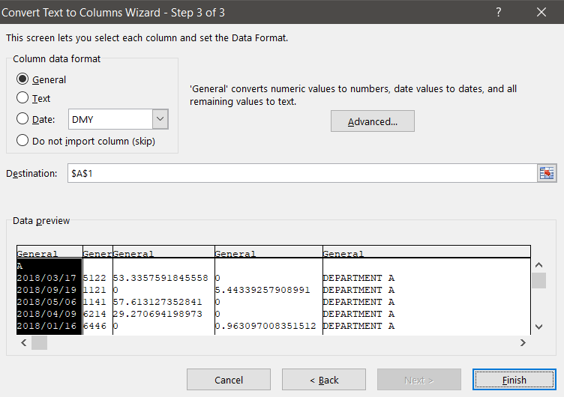
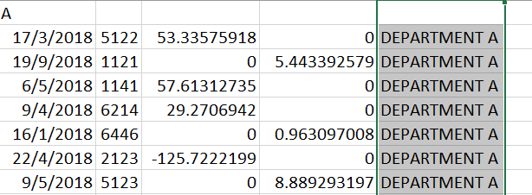
Data Sanitization & Analysis
Unsorted Data 1
Rationalizing the data requires:
“Text to Columns”

Slide 25
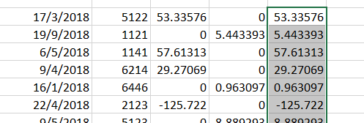
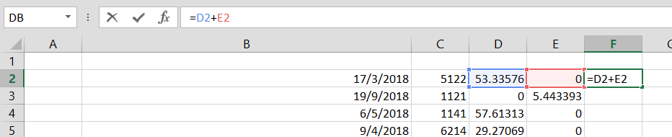
Data Sanitization & Analysis
Unsorted Data 1
Rationalizing the data requires:
“SUM”

Slide 26
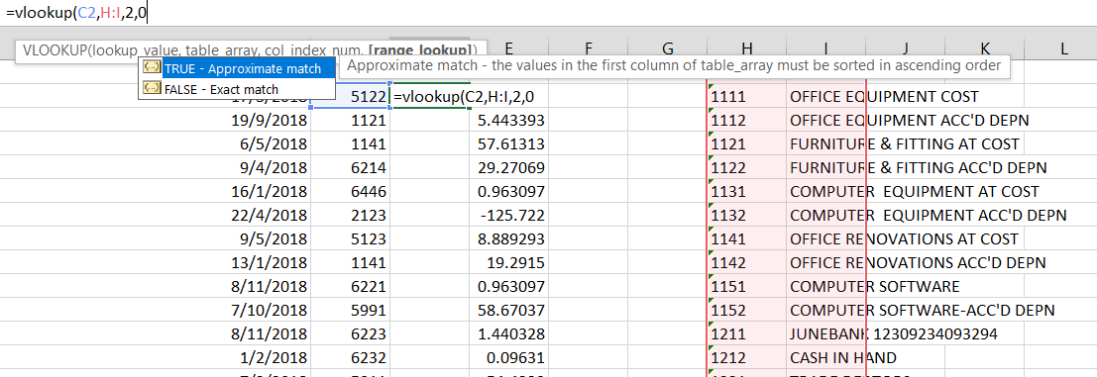
Data Sanitization & Analysis
Unsorted Data 1
Rationalizing the data requires:
“VLOOKUP”

Slide 27
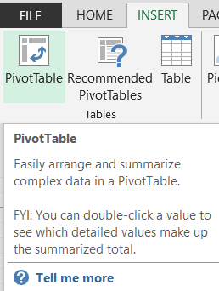
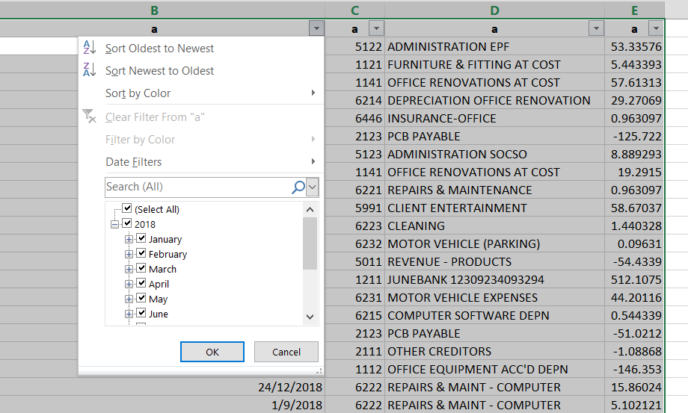
Data Sanitization & Analysis
Unsorted Data 1
Rationalizing the data requires:
“PivotTable”

Slide 28
BONUS: Business Documents
Tax Invoice 1
Components
Merge and center, with formatting
Custom formatting "I-"000000 , @" of "@
“Data Validation”, “List”, e.g. ref: =$M$99:$M$106
Automatic numbering =IF(O34="","",1), =IF(O35="","",M34+1)
=IFERROR(VLOOKUP($O34,$M$90:$P$94,4,0),"")
=IFERROR(-(S34*$T$32),"") links discount to item
https://support.office.com/en-us/article/convert-numbers-into-words-a0d166fb-e1ea-4090-95c8-69442cd55d98
SUM & MULTIPLY formulas
Multiplies RM10/night based on status of reference cell =(SUMIF(R34:R38,"NIGHT(S)",Q34:Q38))*10
General referencing (e.g. “=U46” )

Slide 29
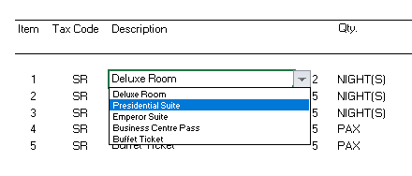
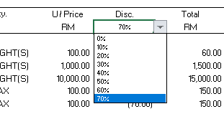
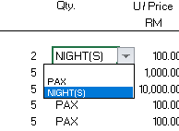
BONUS: Business Documents
Tax Invoice 1
Data Validation List & Reference Data Samples

Slide 30
BONUS: Financial Statements
FREE Templates:
https://templates.office.com/en-us/profit-and-loss
https://templates.office.com/en-au/annual-financial-report-tm00000051
https://templates.office.com/en-au/financial-management

Slide 31
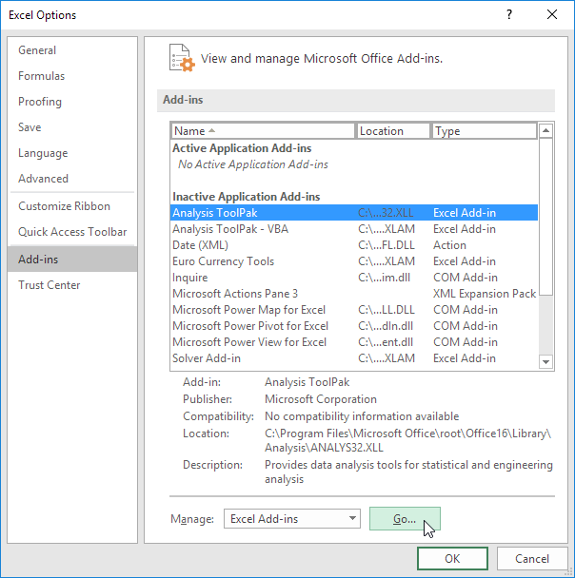
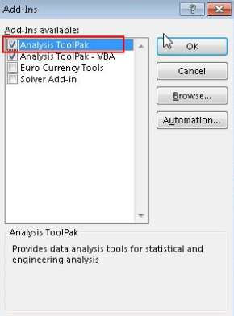
BONUS: Regression & Sensitivity Analysis
Part 1: Regression Analysis
Steps required
Make meaningful derivations of data provided by separate departments.
Go to “Excel Options” and activate Analysis ToolPak Add-In
1.
PROVIDED
PROVIDED
DERIVATION
2.

Slide 32
BONUS: Regression & Sensitivity Analysis
Part 1: Regression Analysis
Steps required
Go to “Data”, and select “Data Analysis”
When highlighting ranges, note the following:
  X-range: Affecting (“Independent Variable”);
  Y-range: Affected (“Dependent Variable”)
  Ensure that you have also highlighted the headers

Slide 33
BONUS: Regression & Sensitivity Analysis
Part 1: Regression Analysis
Datasets

Slide 34
BONUS: Regression & Sensitivity Analysis
Part 1: Regression Analysis
Regression Analysis Output > How to Interpret

Slide 35
BONUS: Regression & Sensitivity Analysis
Part 1: Regression Analysis
Regression Analysis Summary
Scatter Chart with Trend Line

Slide 36
BONUS: Regression & Sensitivity Analysis
Part 2: Sensitivity Analysis
Steps required
Flesh out the formula based on the scenario
“Square root formula”
=SQRT((2*L79*P79)/S102)
1.

Slide 37
BONUS: Regression & Sensitivity Analysis
Part 2: Sensitivity Analysis
Workings to arrive at Formula

Slide 38
BONUS: Regression & Sensitivity Analysis
3.
Part 2: Sensitivity Analysis
Steps required
Create “What-If” table, manually, as per scenario instructions

Slide 39
BONUS: Regression & Sensitivity Analysis
Part 2: Sensitivity Analysis
Scenario Instructions

Slide 40
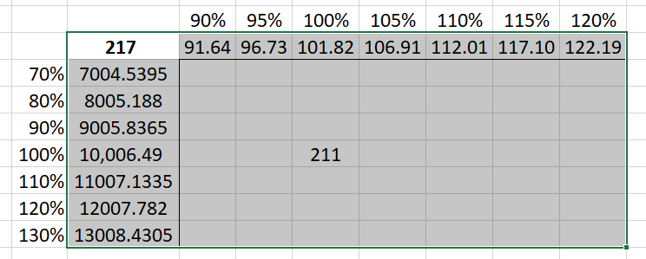
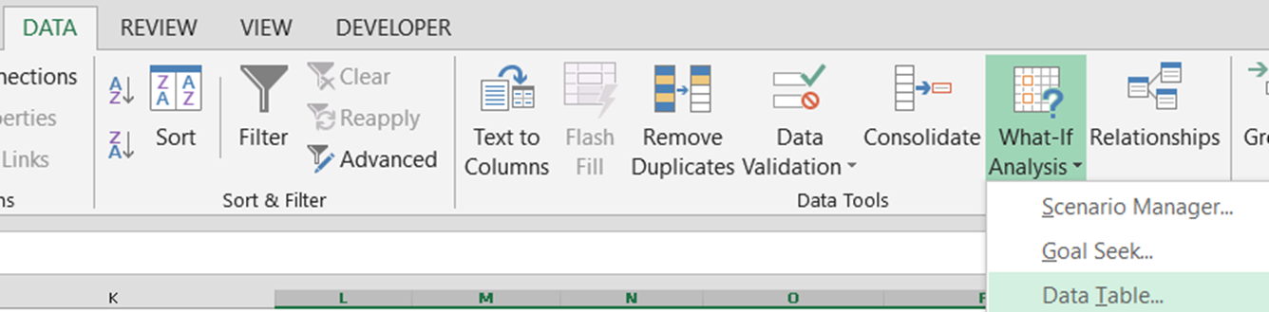
BONUS: Regression & Sensitivity Analysis
4.
Part 2: Sensitivity Analysis
Steps required
Highlight data range and select...
“Data”“What-If Analysis” > “Data Table”
5.

Slide 41
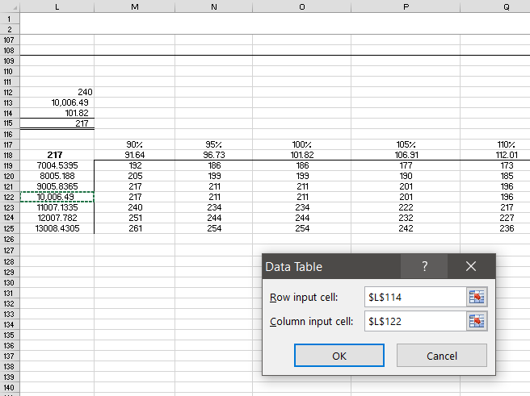
BONUS: Regression & Sensitivity Analysis
Part 2: Sensitivity Analysis
Populating a “What-If” Table

Slide 42
BONUS: Regression & Sensitivity Analysis
Part 2: Sensitivity Analysis
DEPENDENT VARIABLE:
EOQ
VARIABLE (1): HOLDING COST
VARIABLE (2): ORDER COST
“What-If” Table Format (ignore values for this slide)

Slide 43
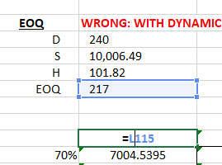
BONUS: Regression & Sensitivity Analysis
Part 2: Sensitivity Analysis
Remember!
Eliminate these formulas at the fringes of the data table, but...
Keep EOQ referencing.

Slide 44
BONUS: Regression & Sensitivity Analysis
Part 2: Sensitivity Analysis
Correct “What-If” Table

Slide 45
BONUS: Regression & Sensitivity Analysis
Part 2: Sensitivity Analysis
Wrong and Correct “What-If” Table Formula-view (part 1)

Slide 46
BONUS: Regression & Sensitivity Analysis
Part 2: Sensitivity Analysis
Wrong and Correct “What-If” Table Formula-view (part 2)

Slide 47

Hope you learnt something useful !
Scan code for feedback:
bit.ly/excelacfb

Slide 48
Revision Slides
bit.ly/excelacppt

